Slide 1
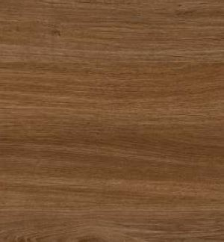

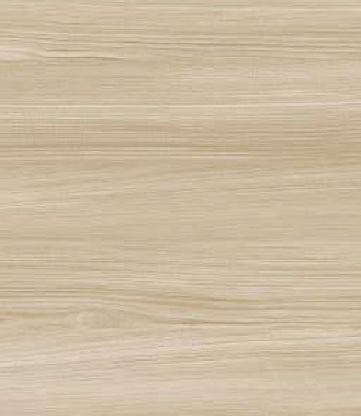
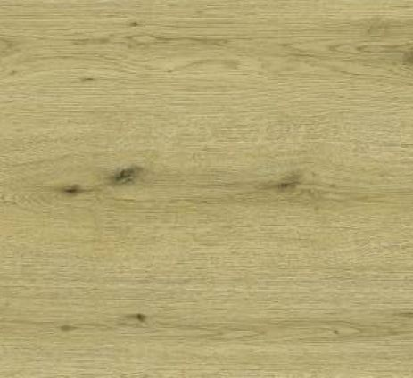
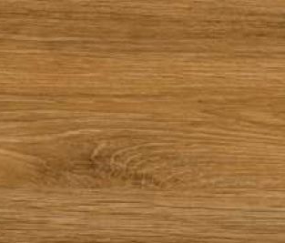

SYMPHONY LAMINATE CATALOGUE
SERIES 1
2106 | HRZ
2121 | HRZ
1503 | HRZ
1305 | HRZ
1401 | HRZ
Amberwood
Chestnut Grove
Frosted Oak
Desert Beech
Sand Dune
SERIES 1
SERIES 1
SERIES 1
SERIES 1
SERIES 1

Slide 2
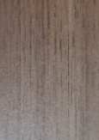
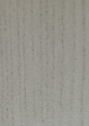
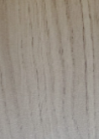
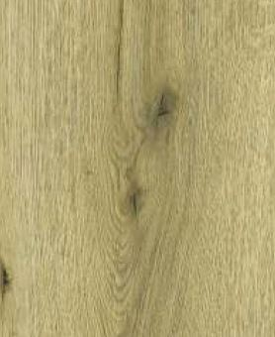
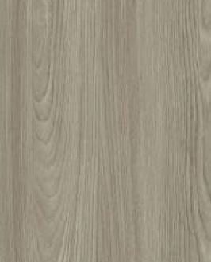
SYMPHONY LAMINATE CATALOGUE
SERIES 1
2145 | SF
2142 | SF
2148 | SF
1401 | SF
1101 | SF
Classic Chestnut
Alpine Maple
Golden Cedar
Sunlit Oak
Urban Timber
SERIES 1
SERIES 1
SERIES 1
SERIES 1
SERIES 1

Slide 3
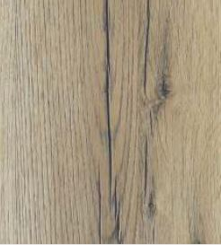
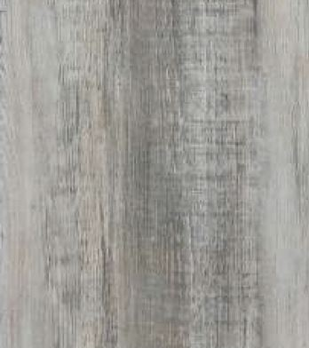
SYMPHONY LAMINATE CATALOGUE
SERIES 1
2127 | SF
1917 | SF
Smoked Chestnut
Nordic Ash
SERIES 1
SERIES 1

Slide 4





SYMPHONY LAMINATE CATALOGUE
SERIES 2
3519 | SLG
3502 | SLG
9053 | HG
9016 | HG
9022 | HG
Cherry Blaze
Pistachio Sheen
Olive Grove
Deep Lagoon
Arctic Breeze
SERIES 2
SERIES 2
SERIES 2
SERIES 2
SERIES 2

Slide 5





SYMPHONY LAMINATE CATALOGUE
SERIES 2
9028 | HG
9033 | HG
9047 | HG
3505 | SLG
9019 | HG
Sienna Bloom
Deep Azure
Silver Veil
Truffle Dust
Cafe Latte
SERIES 2
SERIES 2
SERIES 2
SERIES 2
SERIES 2

Slide 6





SYMPHONY LAMINATE CATALOGUE
SERIES 2
9030 | HG
3559 | SMT
9020 | SMT
9043 | SMT
3575 | SMT
Beige Glow
Ash Grey
Stone Beige
Caramel Tan
Serene Blue
SERIES 2
SERIES 2
SERIES 2
SERIES 2
SERIES 2

Slide 7


SYMPHONY LAMINATE CATALOGUE
SERIES 2
9053 | SMT
9001 | SMT
9022 | SMT
9028 | SMT
9019 | SMT
Forest Green
Snow Drift
Capri Breeze
Blush Suede
Sahara Duna
SERIES 2
SERIES 2
SERIES 2
SERIES 2
SERIES 2

Slide 8




SYMPHONY LAMINATE CATALOGUE
SERIES 2
9030 | SMT
9035 | SMT
9052 | SMT
3586 | SMT
3584 | SMT
Caramel Beige
Mars Clay
Moroccan Red
Moonstone Grey
Concrete Charm
SERIES 2
SERIES 2
SERIES 2
SERIES 2
SERIES 2

Slide 9





SYMPHONY LAMINATE CATALOGUE
SERIES 2
3560 | SMT
3526 | SMT
3514 | SMT
9005 | HG
3601 | SLG
Dark Knight
Deep Sapphire
Honey Gold
Ivory Glaze
Snow White
SERIES 2
SERIES 2
SERIES 2
SERIES 2
SERIES 2

Slide 10

SYMPHONY LAMINATE CATALOGUE
SERIES 2
3502 | SMT
Matcha Tan
SERIES 2

Slide 11
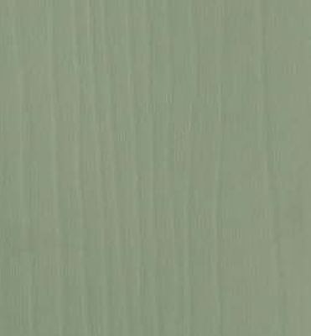

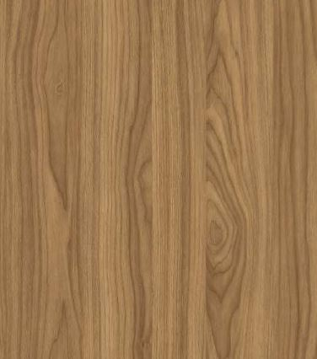
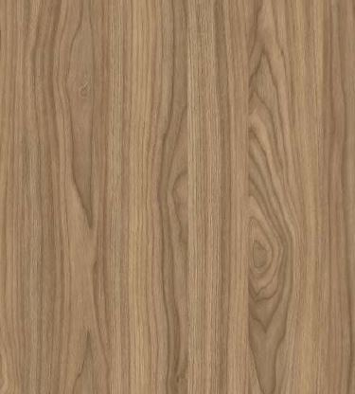
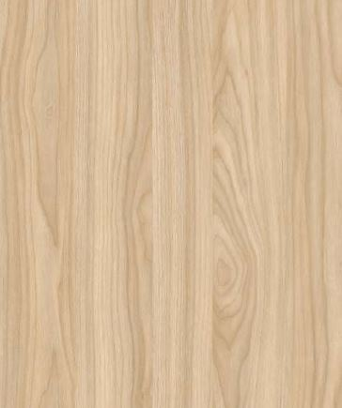
SYMPHONY LAMINATE CATALOGUE
SERIES 3
3502 | FN
3584 | FN
3213 | NG
3204 | NG
3201 | NG
Pistachio Timber
Moonstone Ash
Heritage Walnut
Twilight Walnut
Ivory Oak
SERIES 3
SERIES 3
SERIES 3
SERIES 3
SERIES 3

Slide 12

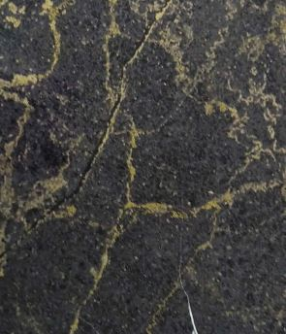


SYMPHONY LAMINATE CATALOGUE
SERIES 3
6933 | ST
6961 | GE
3528 | SC
3560 | SC
3701 | SC
Phantom Granite
Celestial Ash
Almond Cream
Lava Rock
Celestial Snow
SERIES 3
SERIES 3
SERIES 3
SERIES 3
SERIES 3

Slide 13
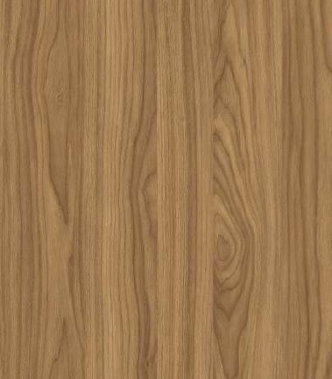
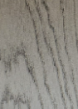
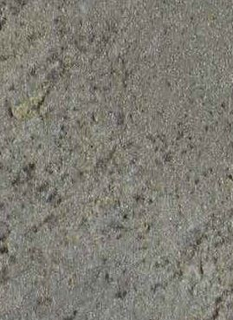
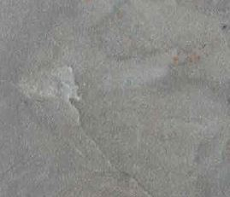

SYMPHONY LAMINATE CATALOGUE
SERIES 3
3216 | NG
3309 | WS
6926 | ST
6929 | ST
3586 | SC
Cinnamon Timber
Smoky Oak
Athens Marble
Himalayan Quartz
Siberian Slate
SERIES 3
SERIES 3
SERIES 3
SERIES 3
SERIES 3

Slide 14
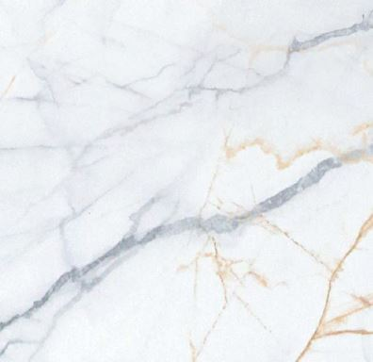
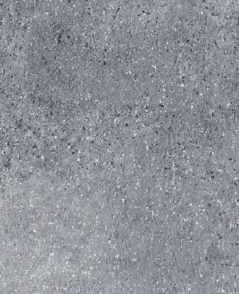
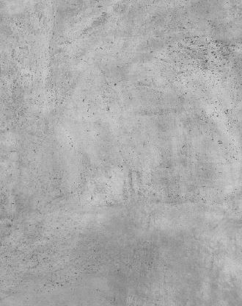
SYMPHONY LAMINATE CATALOGUE
SERIES 3
2703 | SC
2718 | SC
2715 | SC
Polar Aura
Charcoal Elegance
Canyon Brown
SERIES 3
SERIES 3
SERIES 3

